Slide 1
Structure determinants for CO₂ transport of human aquaporin5
Gas Channel Workshop
Xue Qin
PI: Walter F Boron
Department of Physiology and Biophysics
Case Western Reserve University

Slide 2
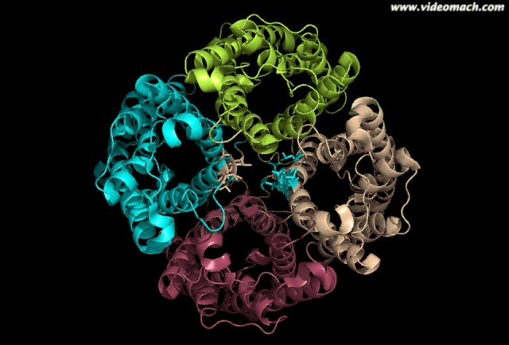
Background
Aquaporin 5 is a water channel highly expressed in salivary glands, eye, lung and trachea.
Aquaporins are composed of 6 transmembrane domains, with N- and C- terminus on the cytoplasmic side of the membrane.
E
A
C
Fig
5
Topology of AQP1
1
2
3
4
5
6
D
B
Repeated NPA motifs
H
2
N
COOH

Slide 3
Background
H₂O permeability
2 filter regions is important for H₂O transport
Selectivity filter: ar/R region
NPA region
n
n
CO₂ permeability
Not well defined
Horsefield et al, 2008 PNAS

Slide 4
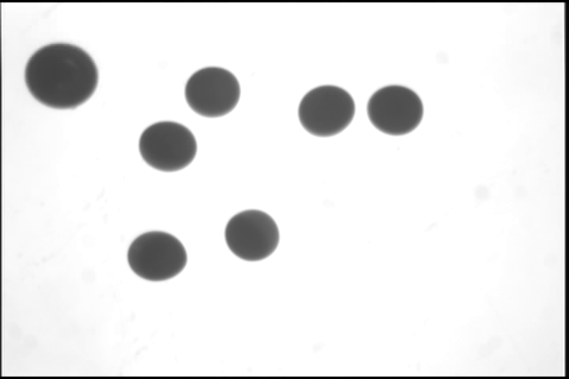
Methods
H₂O permeability--P_{f}
Volumetric assay to measure osmotic water permeability
How fast the volume of oocytes change with time
CO₂ permeability--ΔpH_{S}
Microelectrode to measure pH on the surface of the oocytes

Slide 5
Outline
I Amino acids at the mouth of the central pore
II Amino acids lining the central pore

Slide 6
Outline
I Amino acids at the mouth of the central pore
II Amino acids lining the central pore

Slide 7
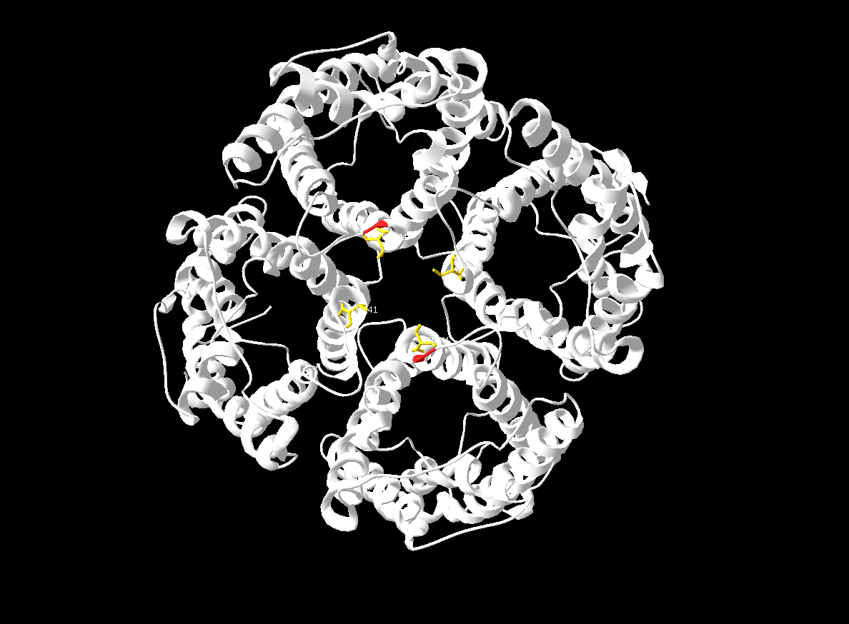
water pore
central pore

Slide 8
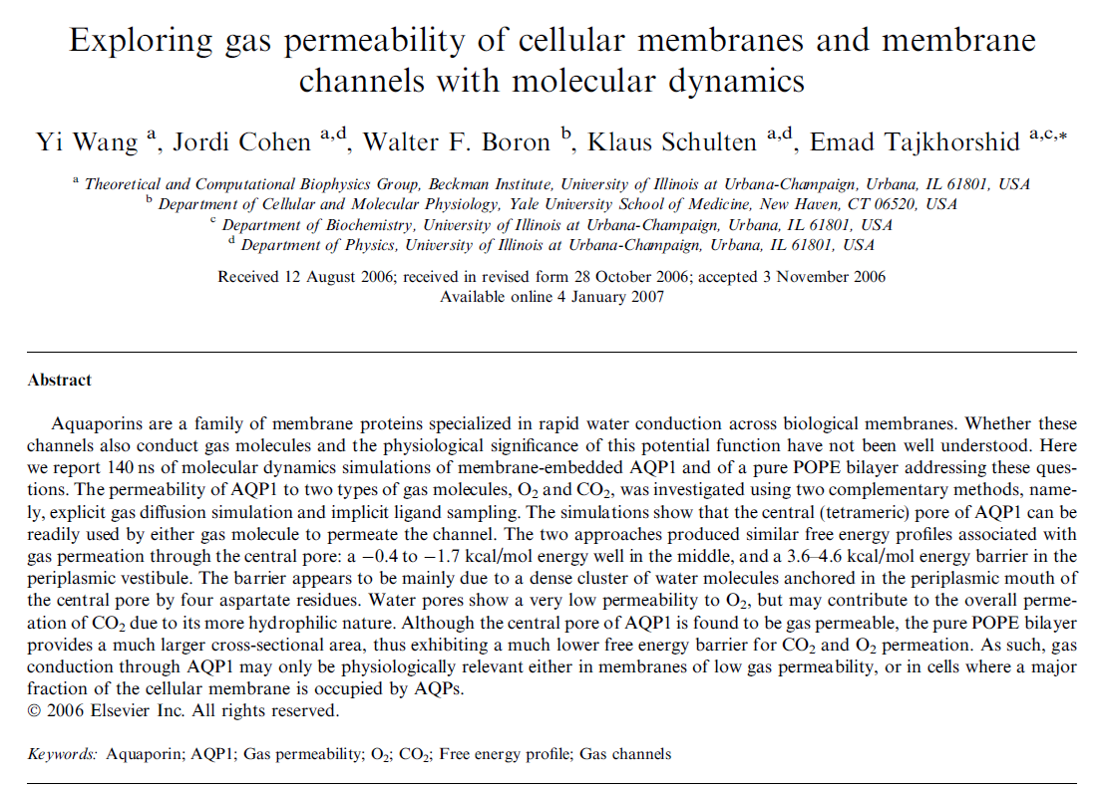

Slide 9
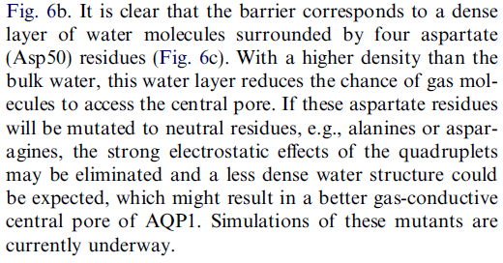
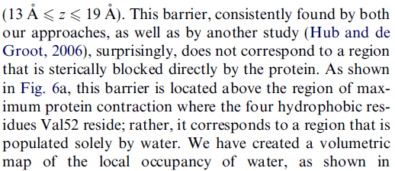
3

Slide 10
Protein sequence alignment
D50
V52
T41
L43

Slide 11
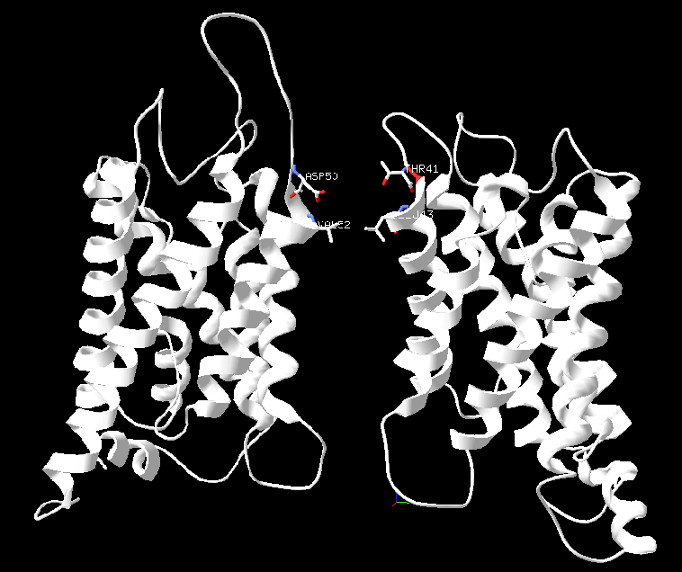
bAQP1
hAQP5

Slide 12
0.004
0.003
P_{f} (cm/s)
0.002
0.001
0.000
H₂O
hAQP5
T41Y
T41W
T41F
T41G

Slide 13
200
Relative channel-dependent CO₂ permeability
150
100
50
0
hAQP5
T41Y
hAQP5
T41W
hAQP5
T41F
hAQP5
T41G

Slide 14
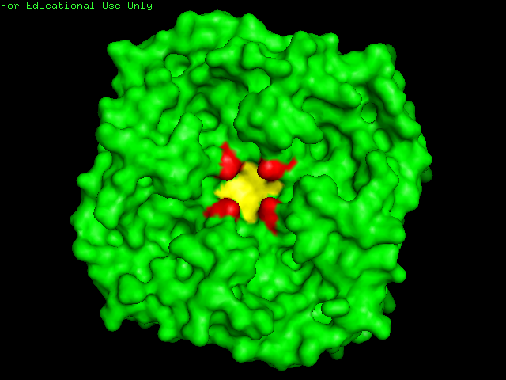
T41
L43

Slide 15
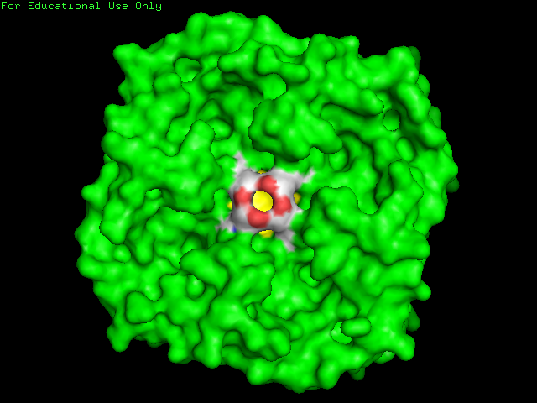
T41Y
T41Y

Slide 16
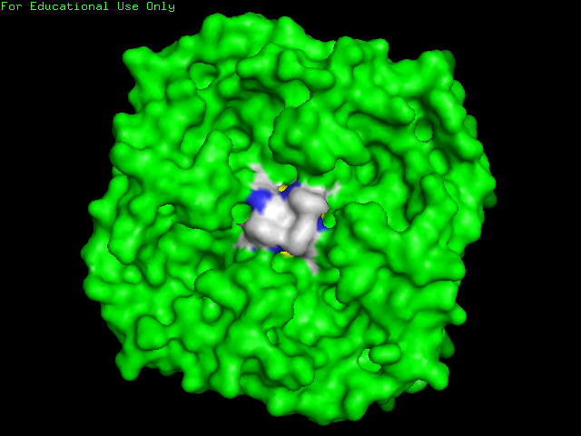
T41W
T41W

Slide 17
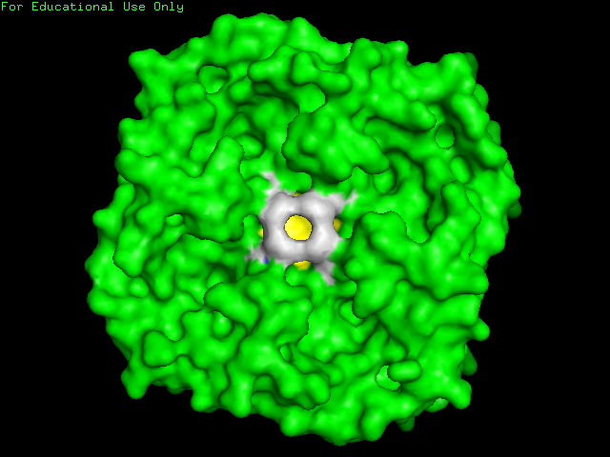
T41F

Slide 18
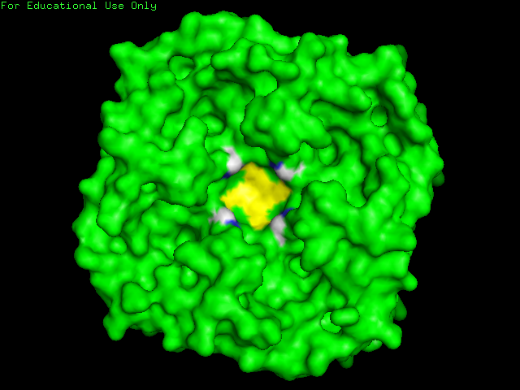
T41G

Slide 19
Conclusion I
I Amino acids at the mouth of the central pore
Changes of ΔpH_{S} (CO₂ permeability) is more sensitive than P_{f} (H₂O permeability)
T41 is more important than L43.
II Amino acids lining the central pore

Slide 20
Outline
I Amino acids at the mouth of the central pore
II Amino acids lining the central pore

Slide 21
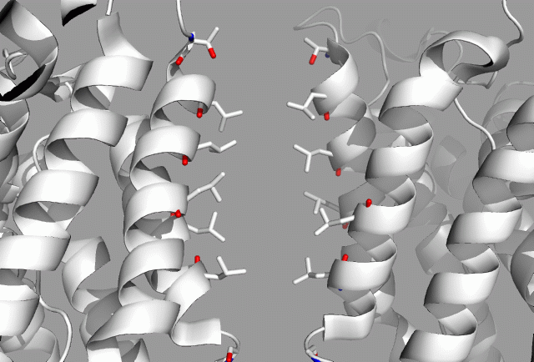
Amino acids lining the central pore
T41
L43
L47
L51
L167
L163
G159

Slide 22
Sequence alignment of AQPs
TM2
TM5

Slide 23
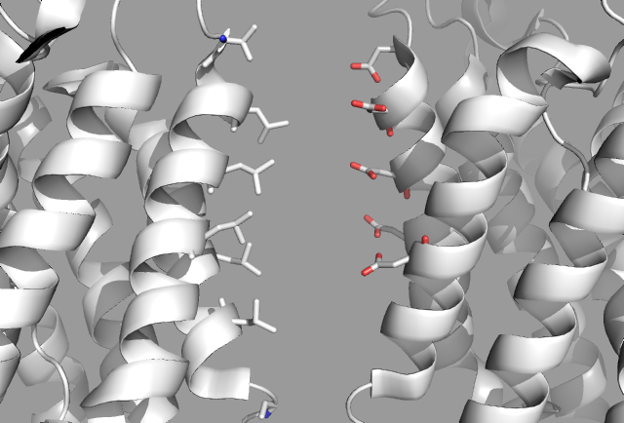
If mutate to Asp (D)
T41
D
D
L43
D
L47
D
L51
L167
D

Slide 24
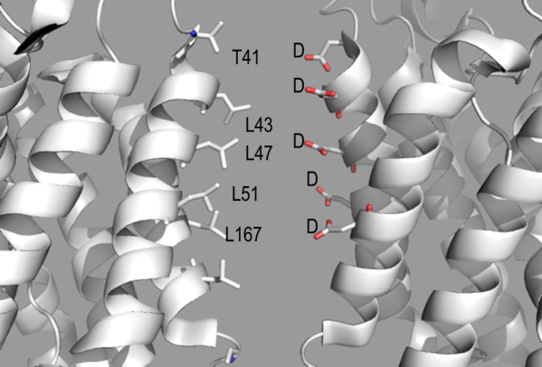
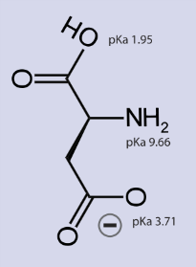
LXXD − ΔpH_{S}*
Aspartic Acid (Asp)
0.09
0.06
Channel-dependent ΔpH_{S} for CO₂
0.03
0.00
hAQP5
T41D
hAQP5
L43D
hAQP5
L47D
hAQP5
L51D
hAQP5
L167D
P_{f}*

Slide 25
LXXD − P_{f}*
Aspartic Acid (Asp)
0.004
0.003
Channel-dependent P_{f} (cm/s)
0.002
0.001
0.000
H₂O
hAQP5
T41D
hAQP5
L43D
hAQP5
L47D
hAQP5
L51D
hAQP5
L167D

Slide 26
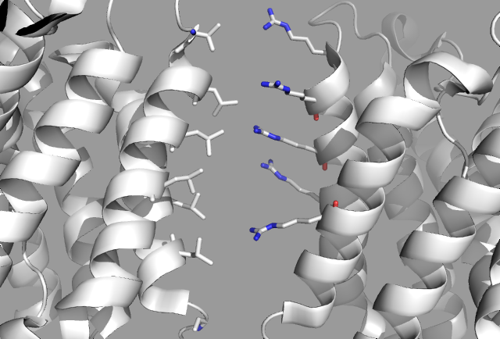
If mutate to Arg (R)
R
T41
R
L43
R
L47
R
L51
L167
R

Slide 27
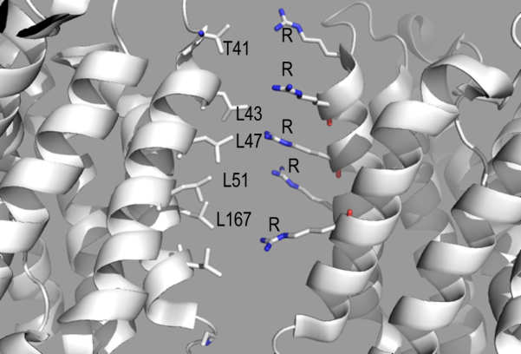
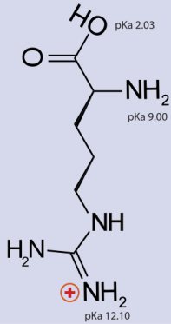
LXXR − ΔpH_{S}*
Arginine (Arg)
0.12
0.10
0.08
Channel-dependent ΔpH_{S} for CO₂
0.06
0.04
0.02
0.00
-0.02
hAQP5
T41R
hAQP5
L43R
hAQP5
L47R
hAQP5
L51R
hAQP5
L167R
P_{f}*

Slide 28
LXXR − P_{f}*
Arginine (Arg)
0.004
0.003
Channel-dependent P_{f} (cm/s)
0.002
0.001
0.000
H₂O
hAQP5
T41R
hAQP5
L43R
hAQP5
L47R
hAQP5
L51R
hAQP5
L167R

Slide 29
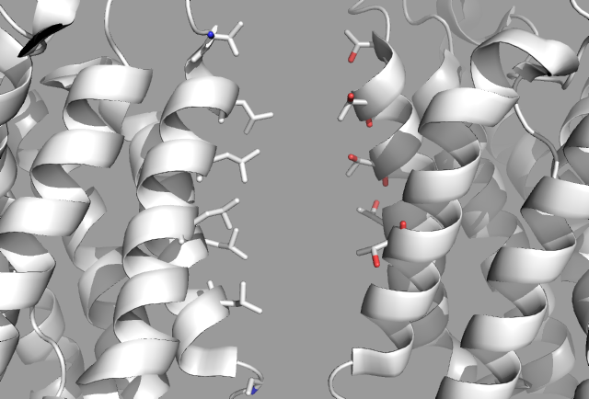
If mutate to Thr (T)
T41
T
T
L43
L47
T
L51
T
L167
T

Slide 30
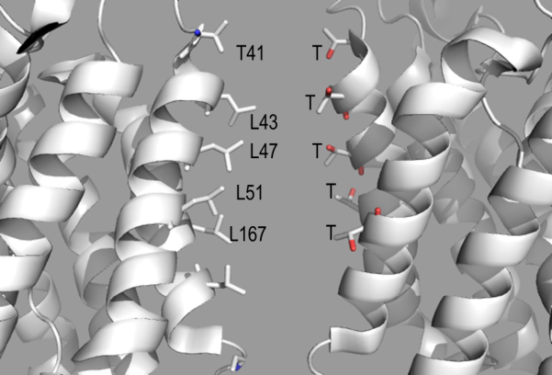
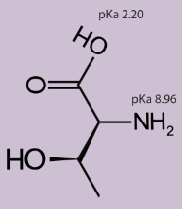
LXXT − ΔpH_{S}*
Threonine (Thr)
0.09
0.06
Channel-dependent ΔpH_{S} for CO₂
0.03
0.00
hAQP5
T41
wt AQP5
hAQP5
L43T
hAQP5
L47T
hAQP5
L51T
hAQP5
L167T
P_{f}*

Slide 31
LXXT − P_{f}*
Threonine (Thr)
0.004
0.003
Channel-dependent P_{f} (cm/s)
0.002
0.001
0.000
H₂O
hAQP5
T41T
hAQP5
L43T
hAQP5
L47T
hAQP5
L51T
hAQP5
L167T
L163T

Slide 32
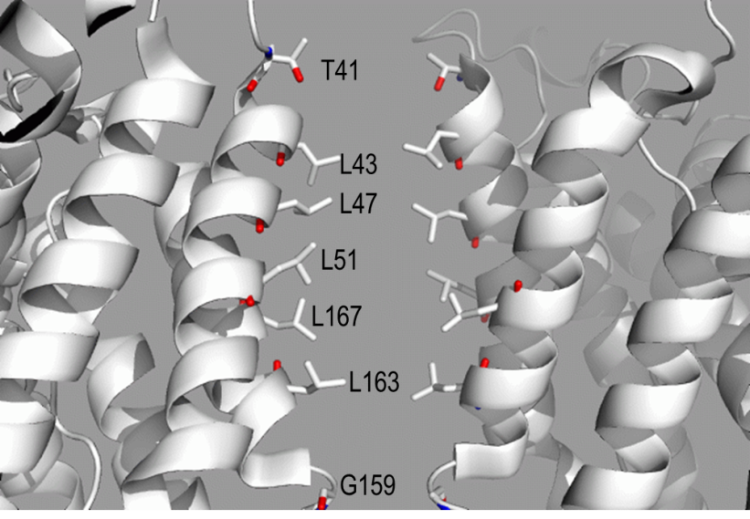
Conclusion II
I Amino acids at the mouth of the central pore
Changes of ΔpH_{S} (CO₂ permeability) is more sensitive than P_{f} (H₂O permeability)
T41 is more important than L43.
II Amino acids lining the central pore
Changes of P_{f} (H₂O permeability) is more sensitive than ΔpH_{S} (CO₂ permeability)
Of all the amino acids lining the central pore, L51 is most sensitive to determine P_{f} and ΔpH_{S.}

Slide 33


Acknowledgement
Collaborator
Emad Tajkhorshid
Lab
Walter F Boron
Raif Musa-Aziz
Mark D Parker

