Slide 1
Role of Rh glycoproteins in NH₃ gas transport –lessons from in vivo model systems
David Weiner, M.D.
University of Florida College of Medicine and NF/SGVHS

Slide 2
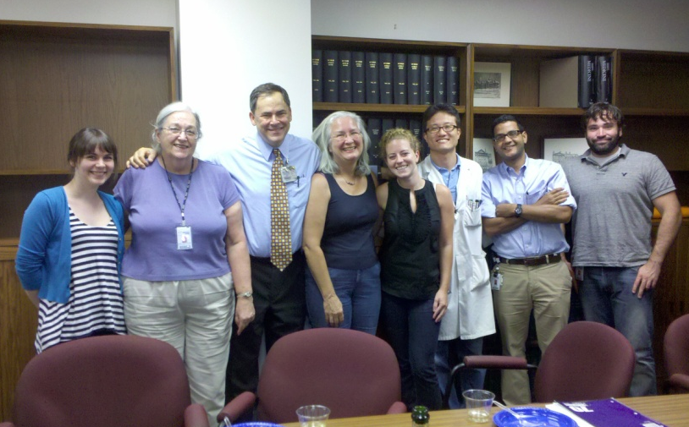
Thanks …
Jill W. Verlander, D.V.M.
Mary E. Handlogten, M.Sc.
Hyun-Wook Lee, Ph.D.
Jesse Bishop, B.Sc.
Melanie N. Cash, B.Sc.
Amy E. Frank, B.Sc.
Hui Guo, Ph.D.
Seong-Pyo Hong, M.D., Ph.D.
George Kasnic, B.S.
Hye-Young Kim, M.D., Ph.D.
Sharon W. Matthews, Ph.D.
Kavya Mekala, M.D.
Manisa Sahni, M.D.
Sriram Seshadri, M.D.
Marshall E. Steinbaum, B.Sc.
Arthur J. Weiner
Florence Whitehill, B.A.
Li Zhang, M.D.
Cre-LoxP studies
  Donald Kohan, M.D., Ph.D.
  Peter Igarashi, M.D.
  Raoul Nelson, M.D., Ph.D.
  Lance Miller, Ph.D.
University of Florida Collaborators
  Bill Clapp, M.D.
  Byron Croker, M.D., Ph.D.
  Kirsten M. Madsen, M.D.
  R. Tyler Miller, M.D.
Clinical fellows:
  Allen Vander, M.D.
  Tom DelGiorno, M.D.
  Kevin Schroeder, M.D.
  Ian Steele, M.D.
  Dietrich Werner, M.D.
New Zealand
  Rob Walker, M.D.
  Jennifer Bedford, Ph.D.
  John Leader, Ph.D.
Ewha Womans University, Seoul, Korea
  Ki-Hwan Han, M.D., Ph.D.
University of Pennsylvania
  Connie M. Westhoff, Ph.D.
Emory University
  Young-Hee Kim, M.D.
  Janet Klein, Ph.D.
  Shelley Kozlowski
  Jeff Sands, M.D.
  Tekla Smith
Funding support: NIH (DK045788, NS047624), Department of Veterans Affairs, American Heart Association, International Society of Nephrology, Korea Science and Engineering Foundation, Gatorade Research Foundation and NF/SGVHS Research Service

Slide 3
Our studies assessing the role of Rh glycoproteins in NH₃ gas transport
Is renal collecting duct NH₃ transport diffusive or transporter-mediated?
Are Rh glycoproteins present in cells that transport NH₃ gas?
Does expression parallel changes in NH₃ gas transport?
Does Rh glycoprotein inhibition alter NH₃ gas transport?

Slide 4
How can we determine whether collecting duct NH₃ transport is diffusive or transporter-mediated?
Inhibitors
Gene knock-down
Functional tests
  Diffusive
    Transport proportional to concentration gradient

Slide 5
How can we determine whether collecting duct NH₃ transport is diffusive or transporter-mediated?
Inhibitors
Gene knock-down
Functional tests
  Diffusive
    Transport proportional to concentration gradient
  Transporter-mediated
    Saturable

Slide 6
Measurement of collecting duct cell (mIMCD-3) basolateral total ammonia transport
Both saturable and diffusive components
J_{total} = J_{transporter} · ([MA] / ([MA] + K_{m}))
+ J_{diffusive} · [MA]
Handlogten, et al, AJP Renal 287:F628-38, 2004.

Slide 7
Characteristics of collecting duct cell (mIMCD-3) basolateral membrane total ammonia transport
Functional characteristics
  Electroneutral
  Na⁺ and K⁺-independent
  Not inhibited by K⁺ transporter or NHE inhibitors
  Extracellular and intracellular pH dependent
  NH₃ transport
Similar findings when studying apical transport
Similar findings in gastric, hepatic, small intestinal and colonic epithelial cells
Handlogten, et al, AJP Renal 287:F628-38, 2004.

Slide 8
Our studies assessing the role of Rh glycoproteins in NH₃ gas transport
Renal collecting duct NH₃ transport is both diffusive and saturable
Are Rh glycoproteins present in cells that transport NH₃ gas?
Does expression parallel changes in NH₃ gas transport?
Does Rh glycoprotein inhibition alter NH₃ gas transport?

Slide 9
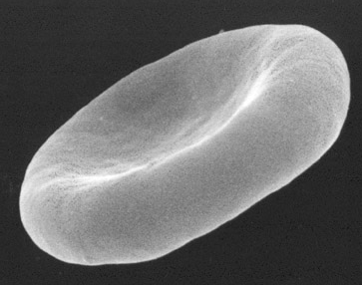
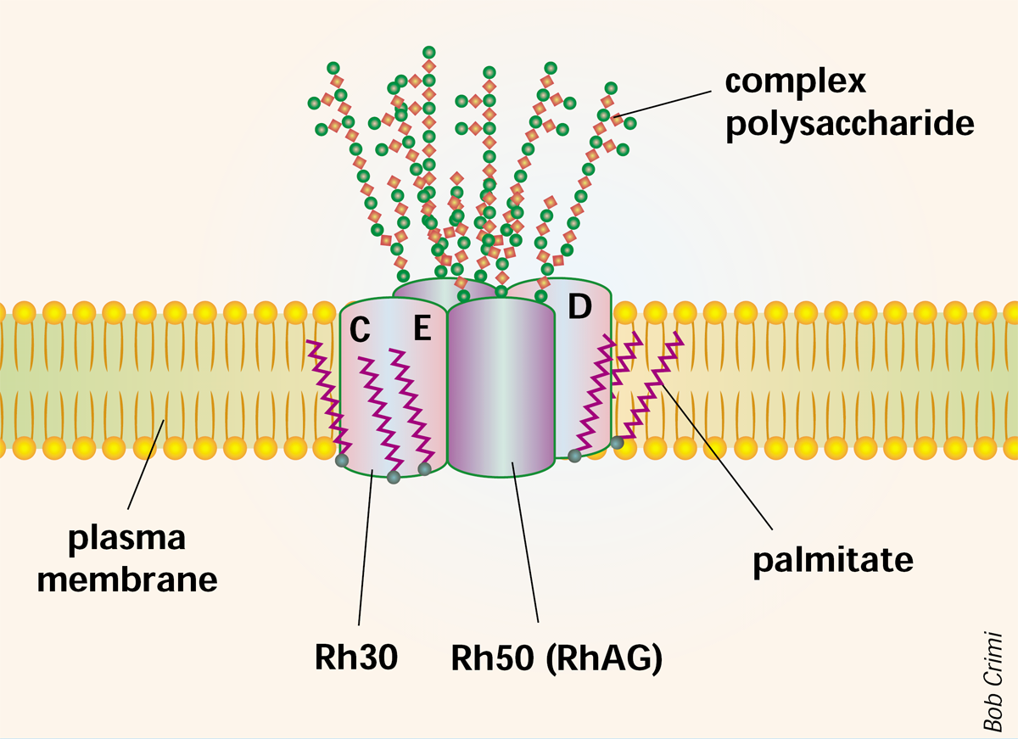
Where is RhAG/Rhag expressed?

Slide 10
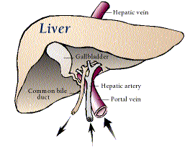
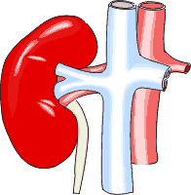
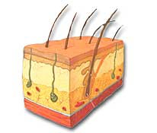
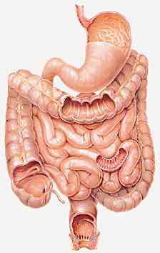
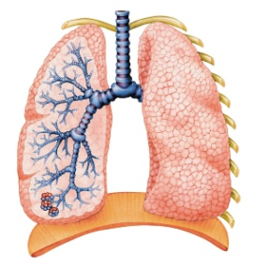
Where is Rhbg expressed?

Slide 11
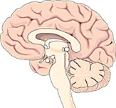
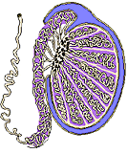

Where is Rhcg expressed?

Slide 12
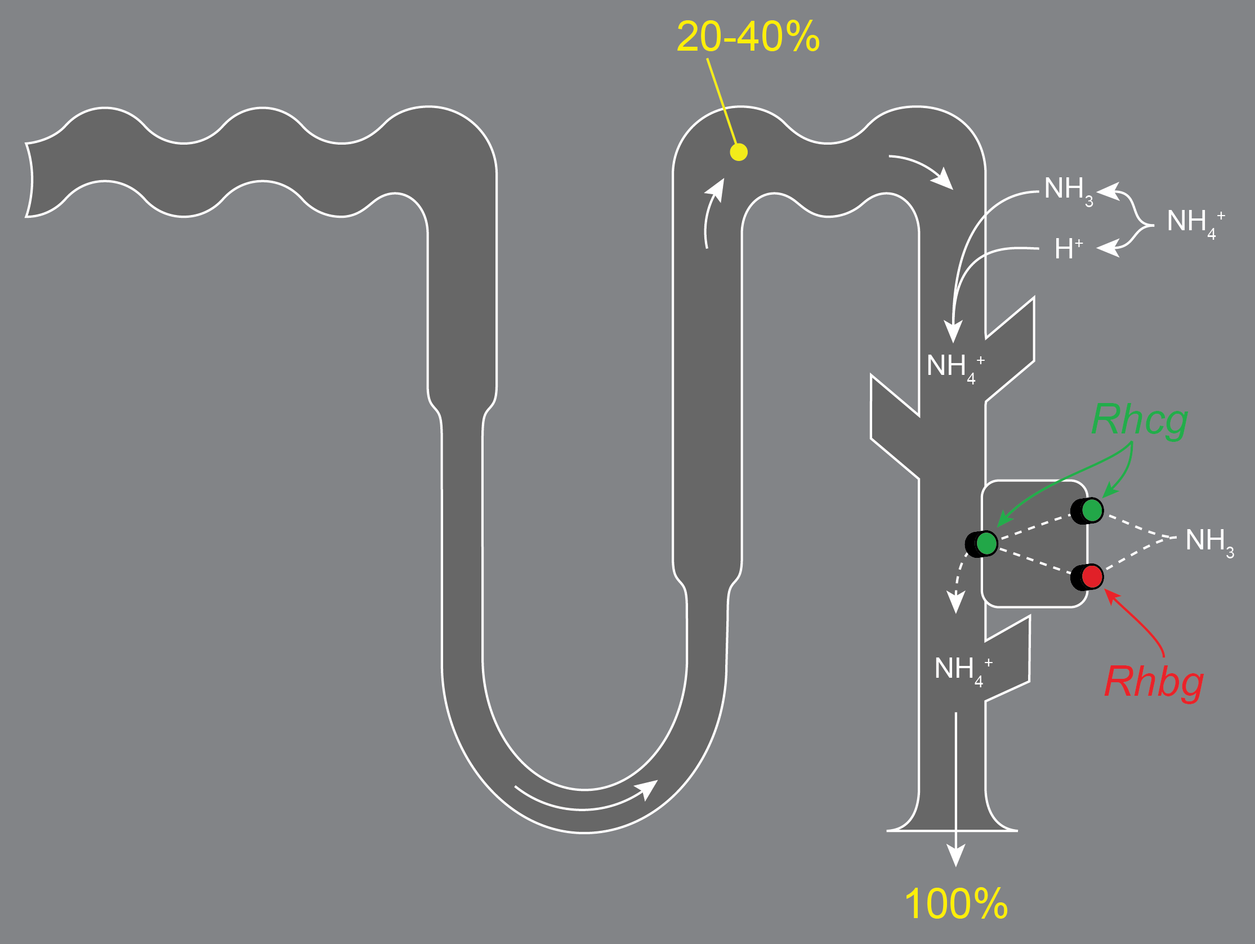
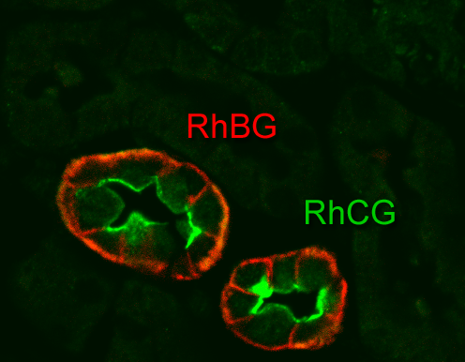
Renal Rh glycoprotein expression
JW Verlander, et al, AJP Renal 284:F323-F337, 2003.

Slide 13
RhCG expression in human kidney
KH Han, et al. JASN 17:2670-9, 2006.

Slide 14
Our studies assessing the role of Rh glycoproteins in NH₃ gas transport
Renal collecting duct NH₃ transport is both diffusive and saturable
Rh glycoproteins are present specifically in cells that transport NH₃
Does expression parallel changes in NH₃ gas transport?
Does Rh glycoprotein inhibition alter NH₃ gas transport?

Slide 15
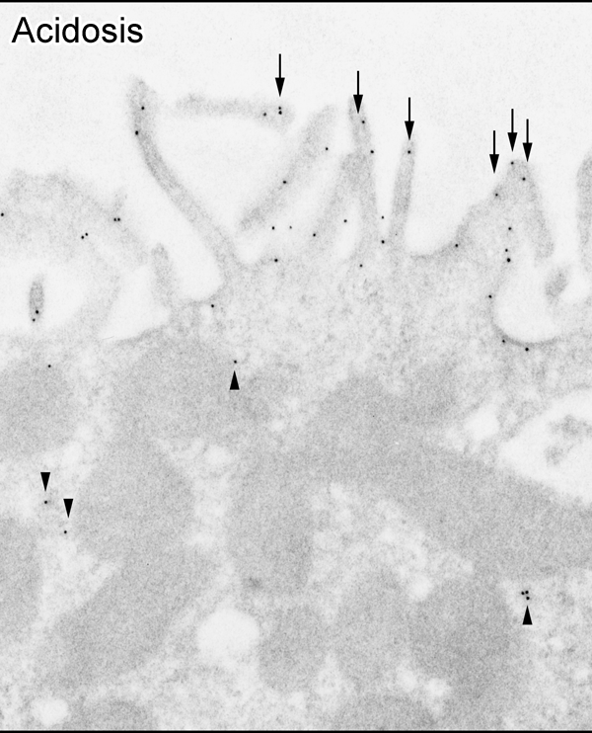
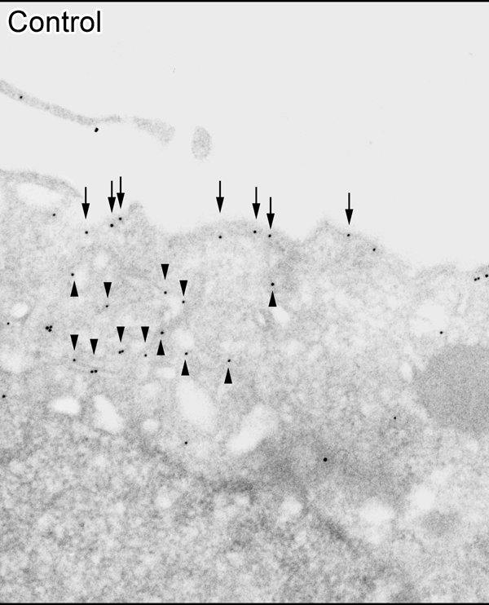
Metabolic acidosis increases apical plasma membrane Rhcg expression
At least two modes of Rhcg regulation:
  Changes in steady-state protein expression
    Post-translational regulation
  Trafficking to and from plasma membrane
Relative roles of each are cell-specific
Seshadri RM, et al. AJP Renal 290: F1443-F1452, 2006.

Slide 16
Metabolic acidosis increases Rhbg expression
JM Bishop, et al. AJP Renal 299:F1067-77, 2010.

Slide 17
Conditions where Rhbg and/or Rhcg expression parallels ammonia transport
Metabolic acidosis
  Seshadri RM, et al, AJP Renal 290: F397-408, 2006.
  Seshadri RM, et al, AJP Renal 290: F1443-52, 2006.
  JM Bishop, et al. AJP Renal 299:F1067-77, 2010.
Reduced renal mass
  HY Kim, et al, AJP Renal 293:F1238-F1247, 2007.
Ischemia-reperfusion injury
  KH Han, et al, AJP Renal 293:F1342-F1354, 2007.
Cyclosporine A-induced renal tubular acidosis
  SW Lim, et al, Nephron Exp Nephrology 110:e49-58, 2008.
Hypokalemia
  KH Han, et al, AJP Renal 301:F823-F832, 2011
Adaptive response to deletion of other acid-base transporters
  Pendrin
    Kim YH, et al, AJP Renal 289:F1262-F1272, 2005.
  Collecting duct Rhcg
    HW Lee, et al, AJP Renal 296:F1364-F1375, 2009.
  Intercalated cell-specific Rhcg
    HW Lee, et al, AJP Renal 299:F369-F379, 2010.
  Intercalated cell-specific Rhbg
    JM Bishop, et al, AJP Renal 299:F1065-F1077, 2010.

Slide 18
Our studies assessing the role of Rh glycoproteins in NH₃ gas transport
Renal collecting duct NH₃ transport is both diffusive and saturable
Rh glycoproteins are present specifically in cells that transport NH₃
Rh glycoprotein expression parallels NH₃ gas transport
Does Rh glycoprotein inhibition alter NH₃ gas transport?

Slide 19
Collecting duct-specific Rhcg deletion
HW Lee, et al, AJP Renal 296:F1364-75, 2009.

Slide 20
Collecting duct-specific Rhcg deletion - basal effects
HW Lee, et al, AJP Renal 296:F1364-75, 2009.

Slide 21
Collecting duct-specific Rhcg deletion - acid loading
Traditional
  Add NH₄Cl to drinking water
  Not well tolerated
    Add glucose
  Hard to quantify
“New”
  Add HCl directly to food
  Use powdered food
  Easily quantified
HW Lee, et al, AJP Renal 296:F1364-75, 2009.

Slide 22
Collecting duct-specific Rhcg deletion - acid loading
Normal expression
(Cre-negative)
Collecting duct deletion
(Cre-positive)
Ammonia excretion different,
P<0.05, at each day
HW Lee, et al, AJP Renal 296:F1364-75, 2009.

Slide 23
Development of intercalated cell-specific Rhbg knock-out mouse
JM Bishop, et al. AJP Renal 299: F1065-77, 2010.

Slide 24
Effect of intercalated cell-specific Rhbg deletion on response to metabolic acidosis
Control
IC-Rhbg-KO
P < 0.05 days 2-4
JM Bishop, et al. AJP Renal 299: F1065-77, 2010.

Slide 25
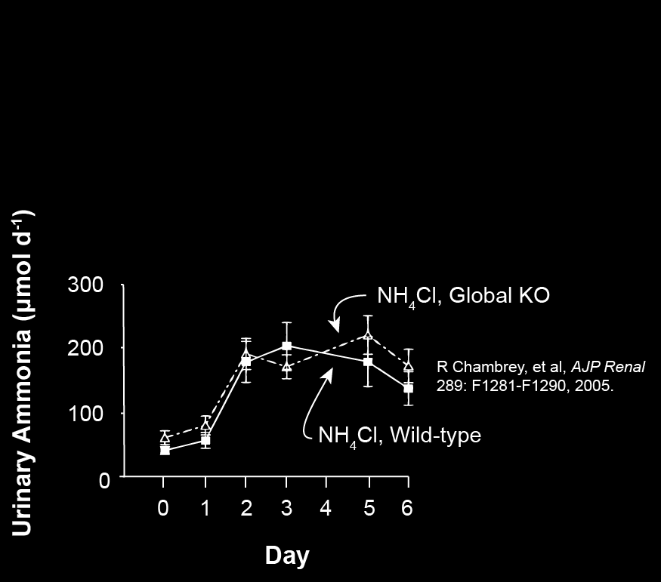
Another Rhbg gene deletion study

Slide 26
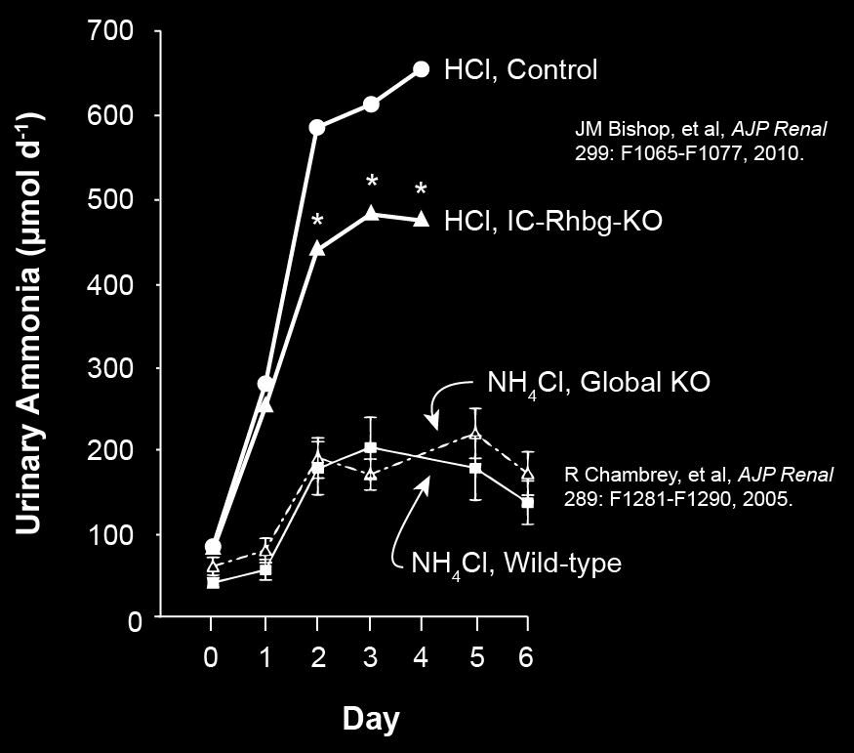
Comparison of the two Rhbg gene deletion studies

Slide 27
Does the role of Rhbg and Rhcg differ in different conditions?
Hypokalemia
  Increased urinary ammonia excretion
  Urine alkalinization
    Increased urine acidification cannot be the primary driving force
  Development of metabolic alkalosis

Slide 28
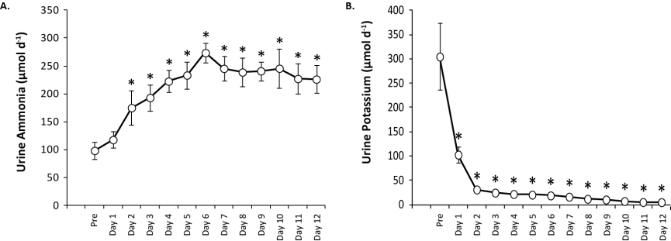
Effect of K⁺-free diet on mouse urinary electrolytes
HW Lee, et al, unpublished data.

Slide 29
Hypokalemia increases Rhcg expression in outer medulla
HW Lee, et al, unpublished data.

Slide 30
Effect of collecting duct-specific Rhcg deletion on response to hypokalemia
HW Lee, et al, unpublished data.

Slide 31
During hypokalemia, Rhcg deletion increases phosphate-dependent glutaminase expression
HW Lee, et al, unpublished data.

Slide 32
Rhbg deletion (from intercalated cells) and response to hypokalemia
Unpublished data.

Slide 33
Rhbg deletion (from intercalated cells) and response to hypokalemia
Unpublished data.

Slide 34
Rhbg deletion (from intercalated cells) does not alter changes in urine pH
Unpublished data.

Slide 35
Effect of Rhbg deletion is on urine ammonia concentration, not urine volume
Unpublished data.

Slide 36
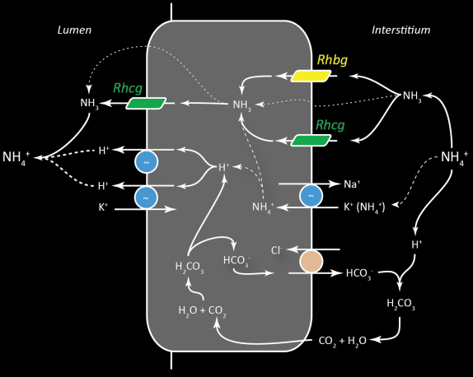
Our studies assessing the role of Rh glycoproteins in NH₃ gas transport
Rh glycoprotein-mediated NH₃ transport is central to renal ammonia metabolism and transport
Renal collecting duct NH₃ transport is both diffusive and saturable
Rh glycoproteins are present specifically in cells that transport NH₃
Rh glycoprotein expression parallels NH₃ gas transport
Rh glycoprotein gene deletion alter NH₃ gas transport

